Slide 1


Reliable Echo Detection
By:
Richa Padhi(1438260)
Theertha Bharathan(1445457)

Slide 2
Contents
01
Introduction
03
Implementation
3.1 ADC to FFT
02
Methodology
3.2 Models
2.1 Ultrasonic Object Differentiation
04
Conclusion

Slide 3
Introduction
Advancements in
Sensor Systems
Challenges in Object
Differentiation
Importance of Ultrasonic Signals
• Distinguishing materials based on density and
composition poses complex challenges.
• Factors like attenuation, reflection, and noise
impact the accuracy of object classification.
• Innovative sensor technologies enhance precision and reliability in autonomous systems.
• Integration of machine learning algorithms optimizes sensor performance for diverse applications
• Ultrasonic signals play a vital role in non-
destructive testing and medical imaging.
• Analyzing echoes from ultrasonic waves enables
differentiation between materials based on
properties

Slide 4
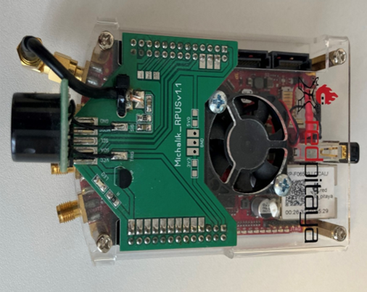
Introduction
Sensor System and Red Pitaya MeasurementBoard

Slide 5
Methodology
Ultrasonic Object Differentiation
Time-of-Flight (ToF) Principle
Pulse-Echo Method
Phase Shift Measurement
Multi-Echo Detection
Dual-Transducer Systems
Temperature Compensation

Slide 6
Methodology
Ultrasonic Object Differentiation
Physical Phenomena and Their Impacts
Attenuation
Reflection and Refraction
Scattering
Multipath Propagation
Noise

Slide 7
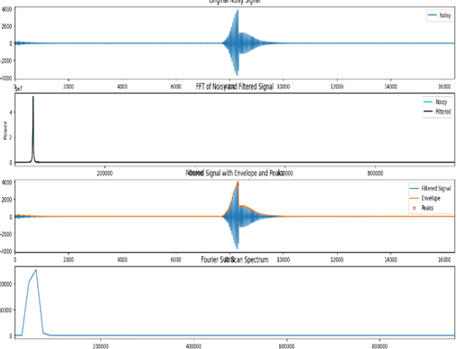
Implementation
ADC to FFT plot for object placed at 1m

Slide 8
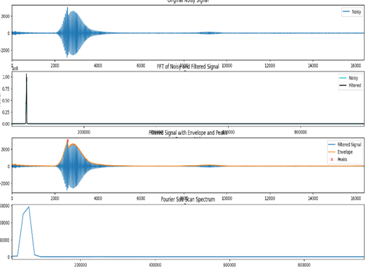
Implementation
ADC to FFT plot for object placed at 50cm

Slide 9
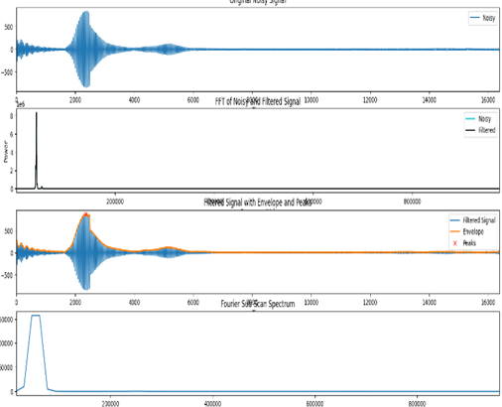
Implementation
ADC to FFT plot for soft object standing

Slide 10
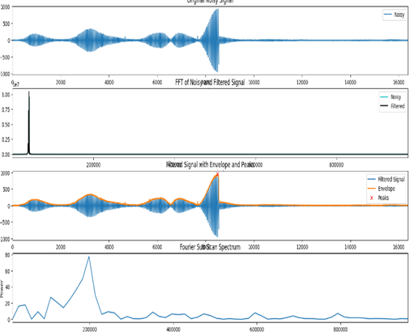
Implementation
ADC to FFT plot for soft object sitting

Slide 11
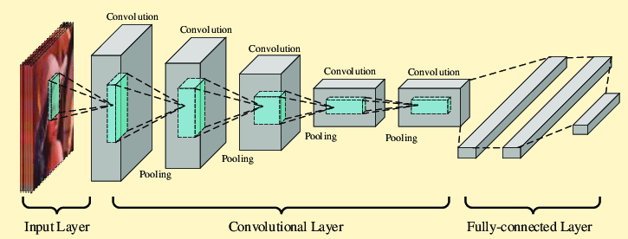
Implementation
Models
CNN (Convolutional Neural Networks )

Slide 12
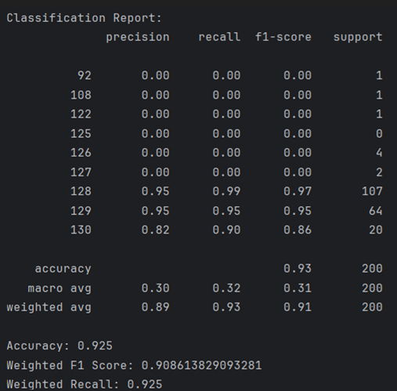
Implementation
CNN (Convolutional Neural Networks )

Slide 13
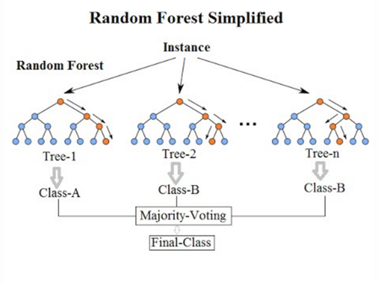
Implementation
Random Forest

Slide 14
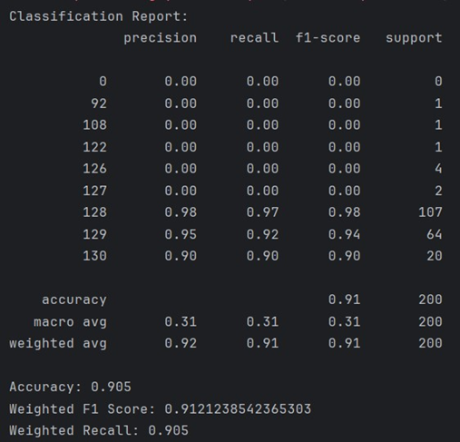
Implementation
Random Forest

Slide 15
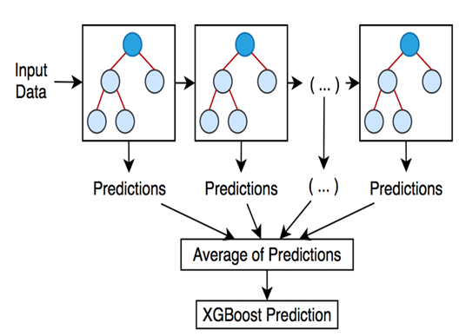
Implementation
XG Boost

Slide 16
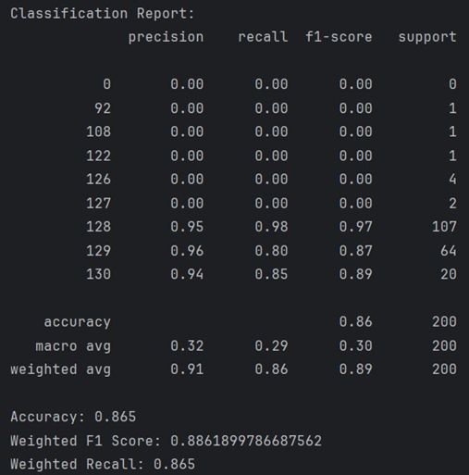
Implementation
XG Boost

Slide 17
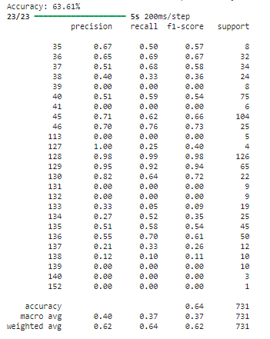
Implementation
CNN Model for combined dataset

Slide 18
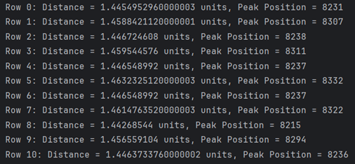
Implementation
Distance and Peak Position Calculation

Slide 19
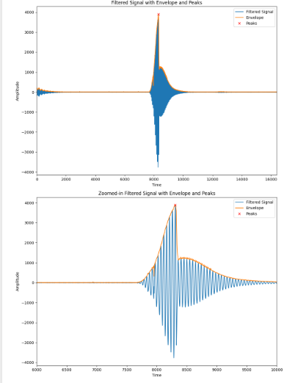
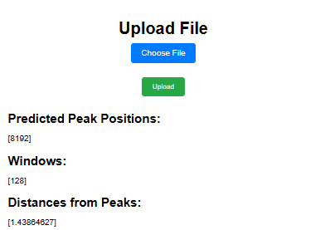
Implementation
GUI Implementation

Slide 20
﻿Conclusion
Comparative analysis of CNN, Random Forest, and XGBoost models on the 1m dataset provided insights into their strengths and weaknesses
Utilized Red Pitaya STEMLAB board and Ultrasonic sensor SRF02 to locate the first echo from ultrasonic waves, revealing varied behavior with different materials.
01
02
03
Highlighted the significance of parameter tuning, particularly window size, in balancing accuracy and computational efficiency in signal processing and machine learning tasks.
04
Identified the potential for improving classification rates by augmenting training data volume and considering the use of larger, pre-trained models to enhance precision in predicting the first echo.

Slide 21
Thank You

